Slide 1

A few things to know about

Slide 2

is written directly to people who do not yet know God.
(so send people directly to it.)

Slide 3

Notes:
It’s not like apologetic sites that’s worded to Christians, where you read it, then you have to figure out how to say that to a nonbeliever. EveryStudent.com is built for nonbelievers, so you can send them there directly.

Slide 4
-- It’s safe.
“The thing I love most about EveryStudent is that it’s safe to send a nonbeliever to. I can trust everything on it. I know the person won’t run into something offensive or weird like they might find on a church or apologetic site.”
(staff member)

Slide 5
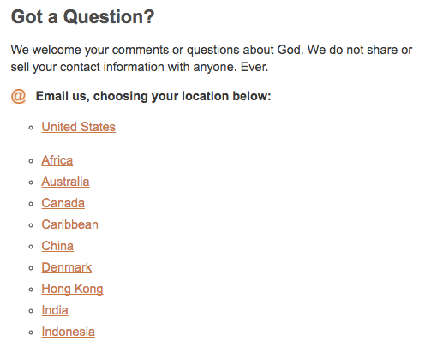
-- A person can ask a question, and it will be answered by a staff member near them.

Slide 6
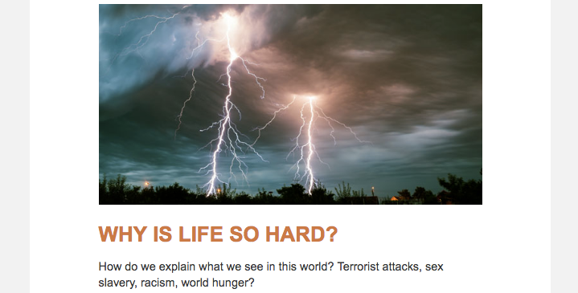
-- It’s written the way people talk.
Notes:
People are willing to read something if it’s interesting and helpful, and if it doesn’t take effort to read it. EveryStudent.com reads quickly without effort.

Slide 7

People stay a long time on EveryStudent.com.
Notes:
Way above the average.

Slide 8
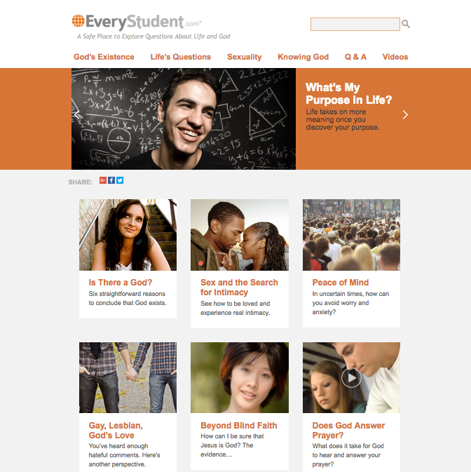
Average time on home page: 1:07

Slide 9
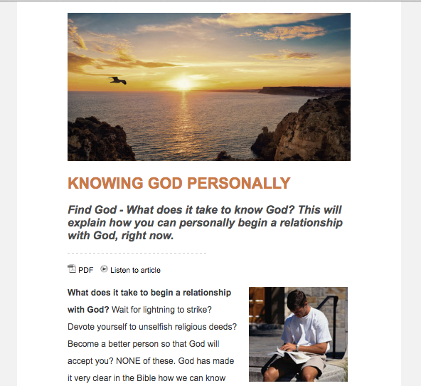
Average time on
Knowing God Personally:
4:12

Slide 10
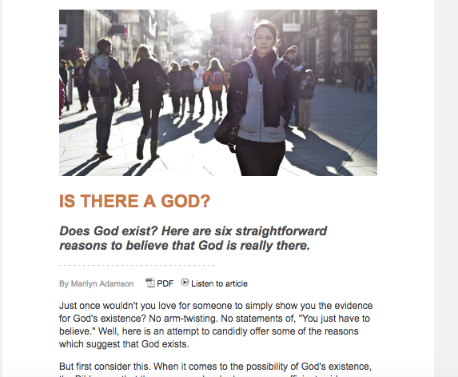
Average time on
Is There a God?
6:00

Slide 11
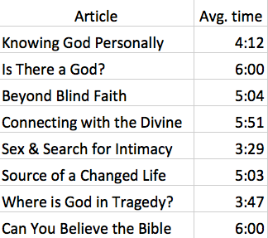
Notes:
The time matches the length of the articles. Longer articles, like Is There a God? Show longer times.

Slide 12
What else should you know about
?
Notes:
As we address people’s most pressing questions about life and God, our goal is not to give them information.

Slide 13

Not just trying to inform.
We are trying to persuade…to move the person toward a relationship with God.
Notes:
****We are not just trying to inform. We are trying to persuade…to move the person toward a relationship with God. So it serves you in your goals...helping people come to know Jesus.

Slide 14
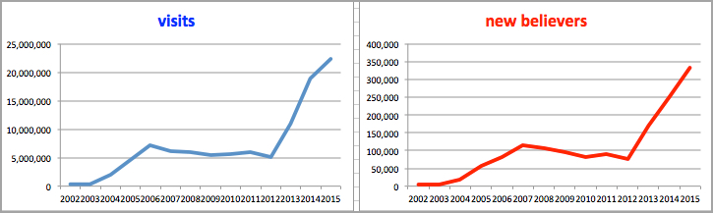
The more people you send to EveryStudent.com, the more who receive Christ.
Notes:
We’ve seen this correlation since the start.

Slide 15
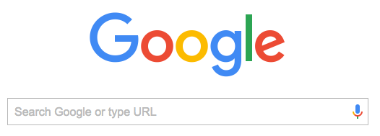
Google the word: God
EveryStudent.com comes up 2nd or 3rd right after Wikipedia.

Slide 16
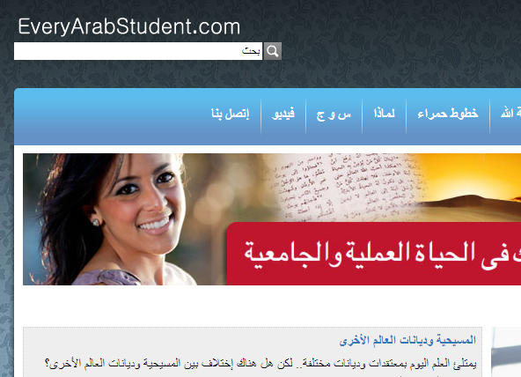
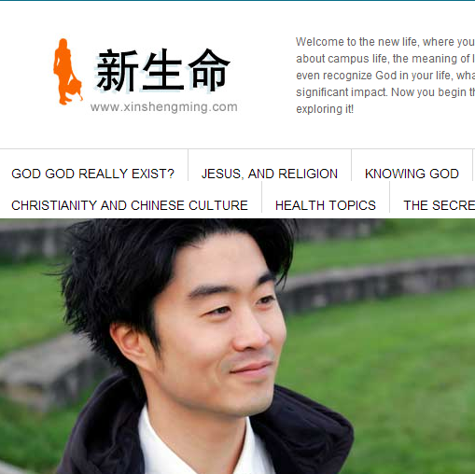
is in 40 languages.

Slide 17
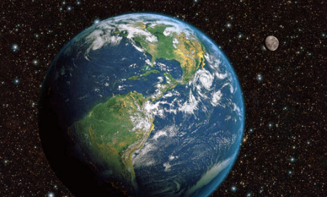
Over 50,000 people a day come to the site from every country of the world.

Slide 18
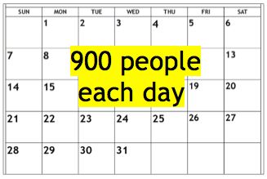
Tell us they’ve asked Jesus into their lives while on the site.
Notes:
We have thousands of comments like this person…

Slide 19
“I got to your website with a question I typed into Google.
Once I found it, I was stuck on it.
I spent a couple of days on it.
Finally I could understand who Jesus is…

Slide 20
…I felt so invited by Him through your site to be in a relationship with Him.
I prayed a prayer of salvation on my knees in my room.
Thank you for making Him understandable to begin with.”

